Slide 1
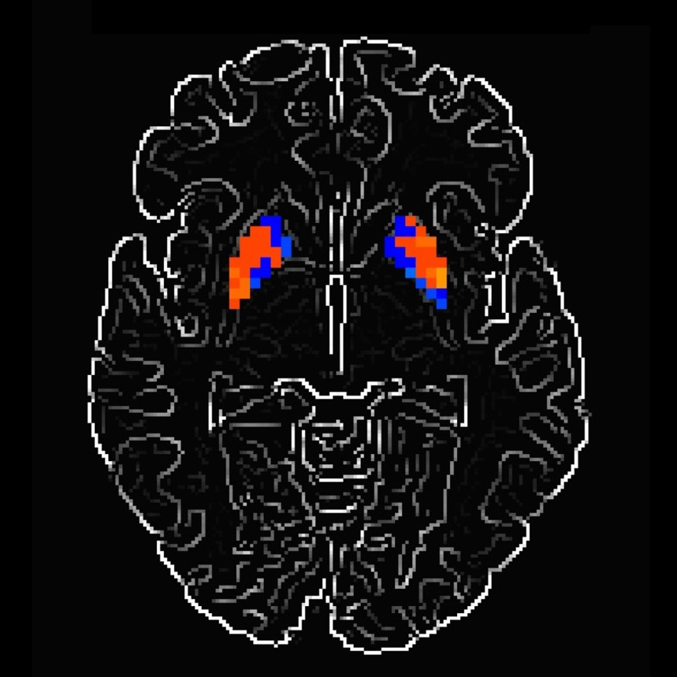
Parkinson's Disease

Slide 2



TEAM MEMBERS
S369978
Eshayat Hasan Chowdhury
S370380
Reduan Raihan
S371689
Iftekhar Bhuiyan
S370937
Aashish
Group
14
Notes:
Links:
https://www.pexels.com/photo/birds-eye-view-photo-of-freight-containers-2226458/
https://www.pexels.com/photo/photo-of-man-in-bubble-jacket-while-holding-tablet-computer-4484077/

Slide 3

Presentation Outline
Objective
Introduction
Project Flowchart
Methodology
Result Interpretation
Variable Identification
Operating Code
Conclusion
Reference
Notes:
Links:
https://www.pexels.com/photo/delivery-man-wearing-a-face-mask-carrying-boxes-4391478/
https://www.pexels.com/photo/man-wearing-a-face-mask-receiving-a-pizza-delivery-4393441/
https://www.pexels.com/photo/person-paying-for-food-delivery-with-a-credit-card-4393532/
https://www.pexels.com/photo/men-putting-food-on-a-thermal-bag-4393665/

Slide 4
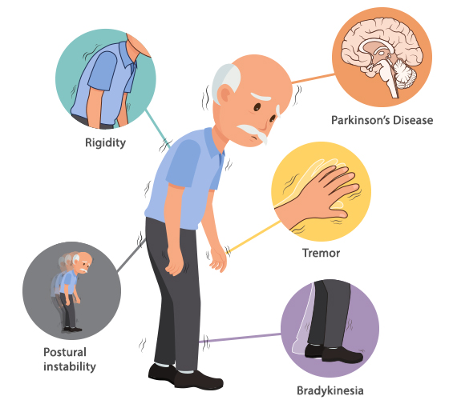
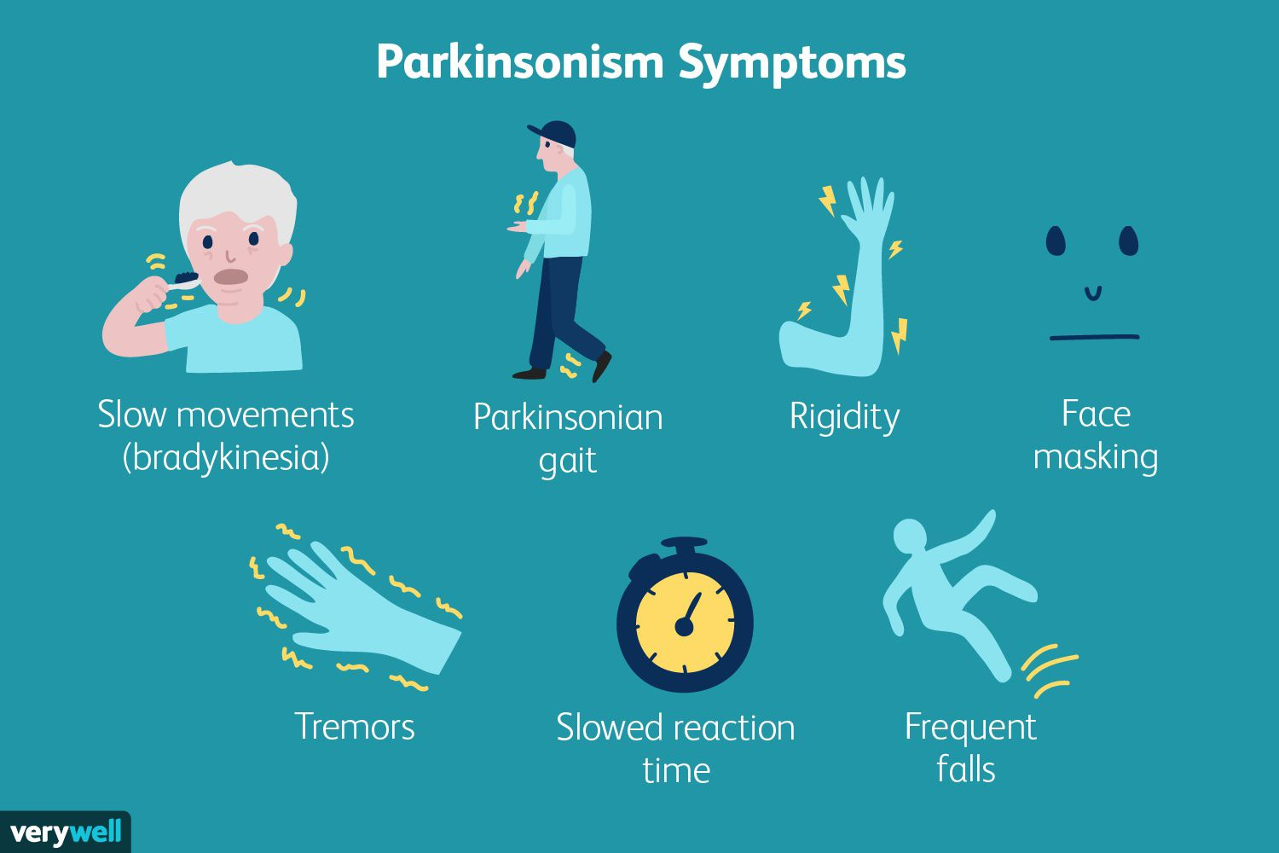
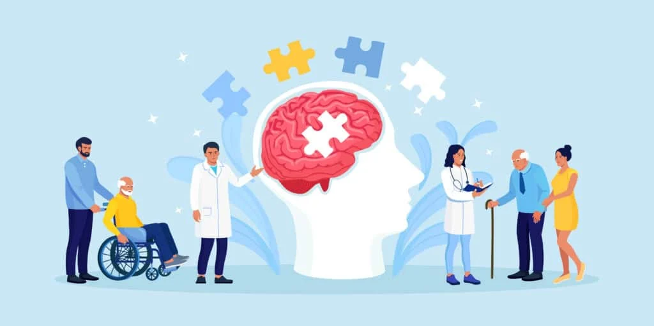

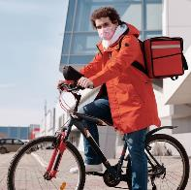




Introduction
Parkinson’s Disease
According to National Institute on Aging, Parkinson’s Disease is a brain disorder that causes unintended or uncontrollable movements such as shaking, stiffness and difficulty in balancing and coordinating [1]. Symptoms usually begin gradually and worsen over time.
Great people suffer
Legendary boxer Mohammad Ali, former U.S. president George H.W Bush, famous actor Megan J. Fox, heavy metal legend Ozzy Osbourne and late Pop John Paul II.
Notes:
Links:
https://www.pexels.com/photo/man-in-white-dress-shirt-and-black-pants-standing-near-glass-window-4604668/
https://www.pexels.com/photo/delivery-man-wearing-a-face-mask-and-riding-a-bicycle-4392030/
https://www.pexels.com/photo/focused-young-female-writing-on-cardboard-boxes-and-preparing-for-relocation-4246122/

Slide 5
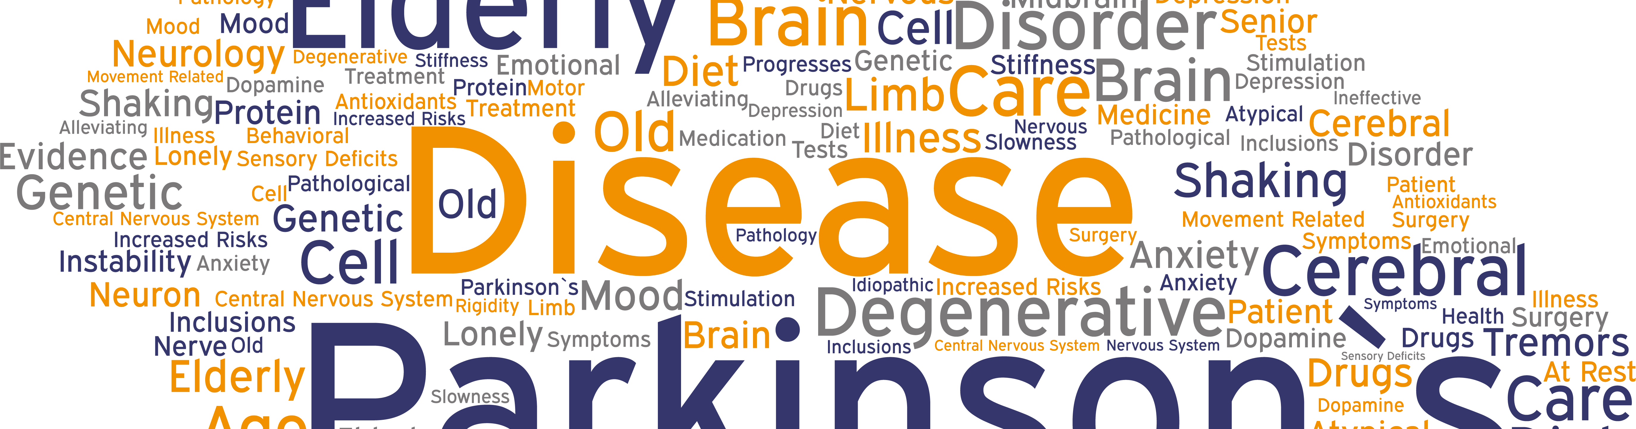
Parkinson’s Disease
Causes [2]
According to Doctor Lauren Fanty, it is still unknown what actually cause Parkin’s Disease. But as per some of the evidence, scientists have found the following things as the cause of Parkinson’s Disease
Genetic Cause
Environmental Factors
10% to 15% people are affected by Parkinson’s Disease due to their genetical issue.
Head injury
Area of residence
Occupation
Exposure to Metals
Solvents & PCBs
Pesticides & Herbicides exposure
Notes:
Links:
https://www.pexels.com/photo/cargo-container-lot-906494/

Slide 6
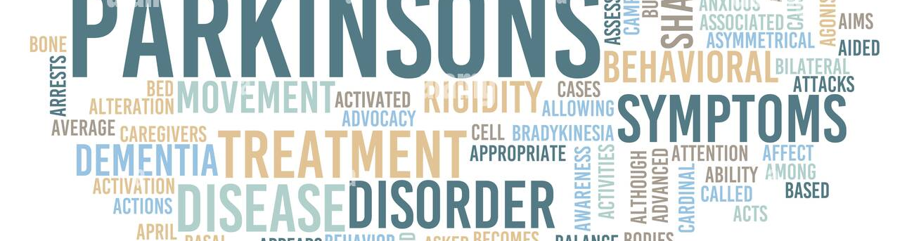
Parkinson’s Disease
Symptoms [3]
Parkinson's disease symptoms can be different for everyone. Early symptoms may be mild and go unnoticed. Symptoms often begin on one side of the body and usually remain worse on that side, even after symptoms begin to affect the limbs on both sides.
Tremor
Rigid Muscles
Speech Changes
Slow Movement
Impaired Posture & Balance
Writing Changes
Notes:
Links:
https://www.pexels.com/photo/cargo-container-lot-906494/

Slide 7
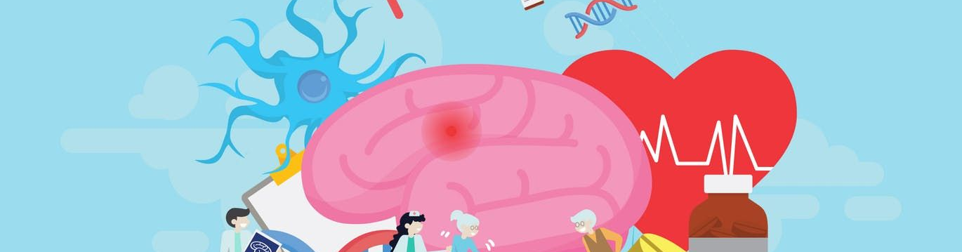
Parkinson’s Disease
Preventions [4]
One can follow the below measures to prevent Parkinson’s Disease.
Eat Organic & Fresh
Vitamin D3
Regular Aerobic Exercise
Incorporate Omega3 into Diet
Green Tea
Antioxidant Rich Foods
Notes:
Links:
https://www.pexels.com/photo/cargo-container-lot-906494/

Slide 8
Parkinson’s Disease
Treatments [5]
As the scientists are still struggling to find the actual cause of Parkinson’s Disease, there are very little amount of treatment scope for this disease. Most commonly used treatment methods are given below:
Deep Brian Stimulation
Levodopa
Carbidopa
Notes:
Links:
https://www.pexels.com/photo/cargo-container-lot-906494/

Slide 9

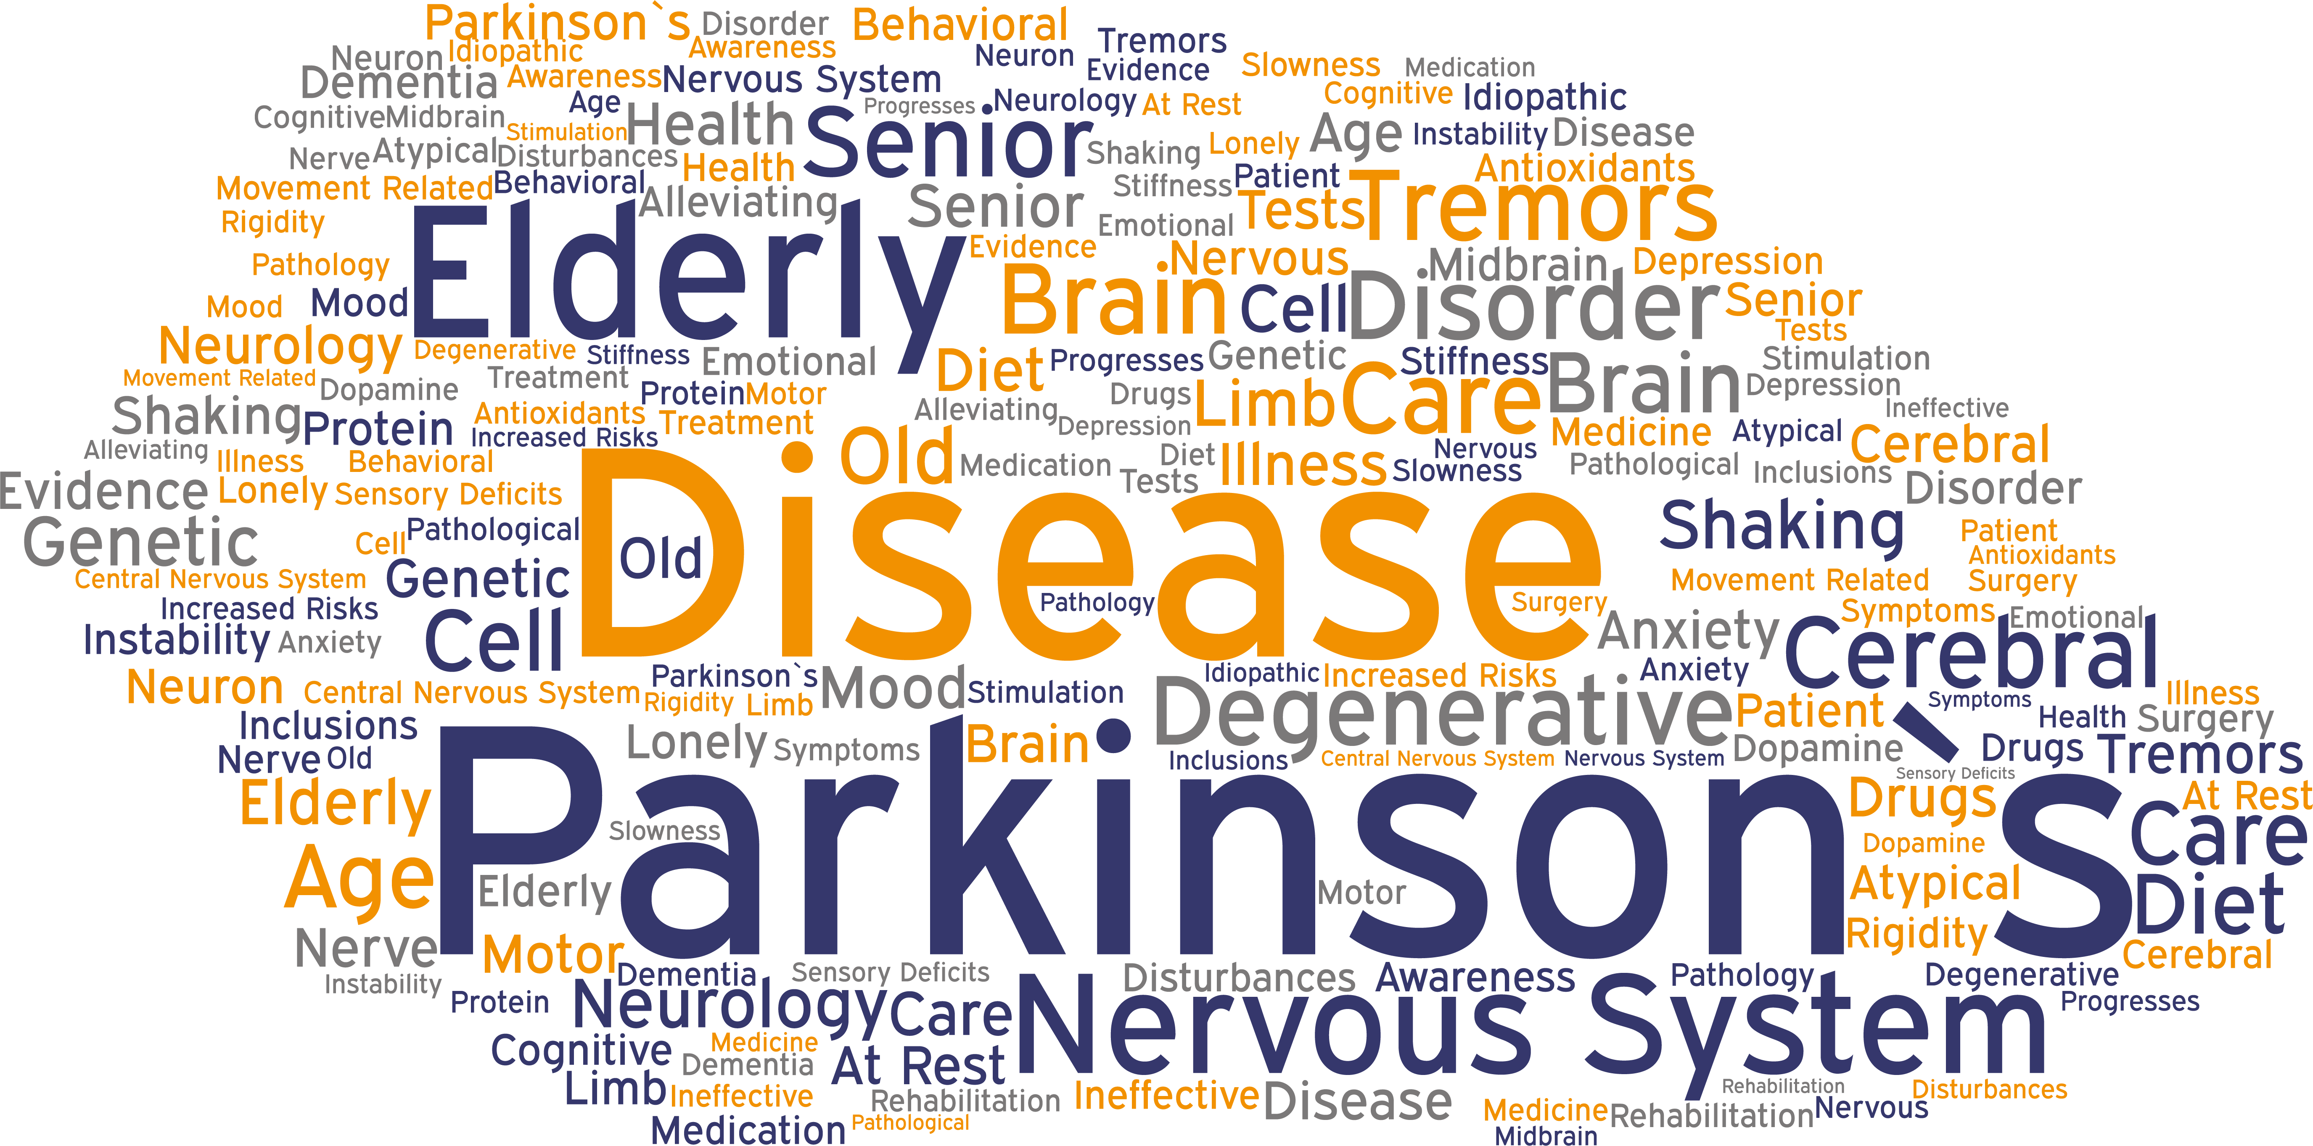
Project Objective
To find out the differentiating variables of people who are affected by Parkinson’s disease and who are not from the given dataset 1
Notes:
Links:
https://www.pexels.com/photo/delivery-man-wearing-a-face-mask-carrying-boxes-4391478/
https://www.pexels.com/photo/man-wearing-a-face-mask-receiving-a-pizza-delivery-4393441/
https://www.pexels.com/photo/person-paying-for-food-delivery-with-a-credit-card-4393532/
https://www.pexels.com/photo/men-putting-food-on-a-thermal-bag-4393665/

Slide 10
Project Flowchart
In this project 5 steps have been followed to complete the project objective which is to find out the differentiating factors of Parkinson’s Disease.
5th
4th
Variables Determination
3rd
Result Interpretation
2nd
Inferential Statistics
Descriptive Statistics
1st
Data Wrangling

Slide 11
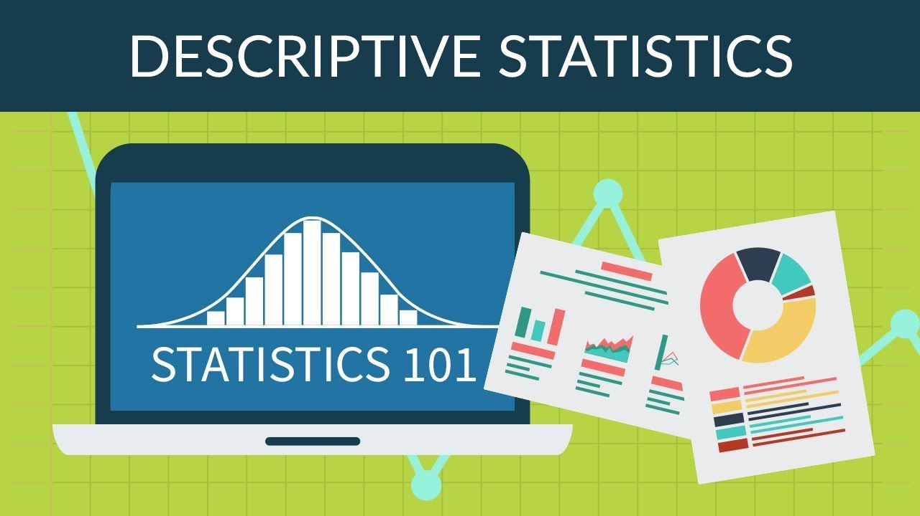


Methodology
Descriptive Statistics
It is used to identify the Mean and Standard Deviation of the given 26 variables
Inferential Statistics
This statistical technic is used to test the hypothesis and finding the actual differentiating variable
Notes:
Links:
https://unsplash.com/photos/mEZ3PoFGs_k
https://unsplash.com/photos/7YVZYZeITc8
https://www.pexels.com/photo/smiling-woman-wearing-black-sweater-1587009/
https://www.pexels.com/photo/smiling-woman-wearing-black-sweater-1587009/

Slide 12

Hypothesis
Null Hypothesis
A particular variable has no affect in a Parkinson’s patient and a healthy individual. In other words, the mean of that particular variable is same for Parkinson’s patient and a healthy individual
Alternative Hypothesis
A particular variable has an affect in a Parkinson’s patient and a healthy individual. In other words, the mean of that particular variable is not same for Parkinson’s patient and a healthy individual
Notes:
Links:
https://unsplash.com/photos/mEZ3PoFGs_k
https://unsplash.com/photos/7YVZYZeITc8
https://www.pexels.com/photo/smiling-woman-wearing-black-sweater-1587009/
https://www.pexels.com/photo/smiling-woman-wearing-black-sweater-1587009/

Slide 13
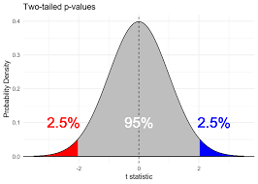
Two Tailed T-Stat
T-Stat
For hypothesis testing we have executed two tailed T-stat. As, we have to compare each variable with two different group that's why this mode of T-stat has been used. With this value we will then calculate our p-value.
Notes:
Links:
https://unsplash.com/photos/mEZ3PoFGs_k
https://unsplash.com/photos/7YVZYZeITc8
https://www.pexels.com/photo/smiling-woman-wearing-black-sweater-1587009/
https://www.pexels.com/photo/smiling-woman-wearing-black-sweater-1587009/

Slide 14



Significance of P-Value
We have conducted our hypothesis testing with 95% confidence level. So, if p<0.05 we reject the null hypothesis of a particular variable but if the p>0.05 then we except the null hypothesis
Notes:
Links:
https://unsplash.com/photos/9cCeS9Sg6nU
https://www.pexels.com/photo/man-holding-digital-tablet-4484155/

Slide 15
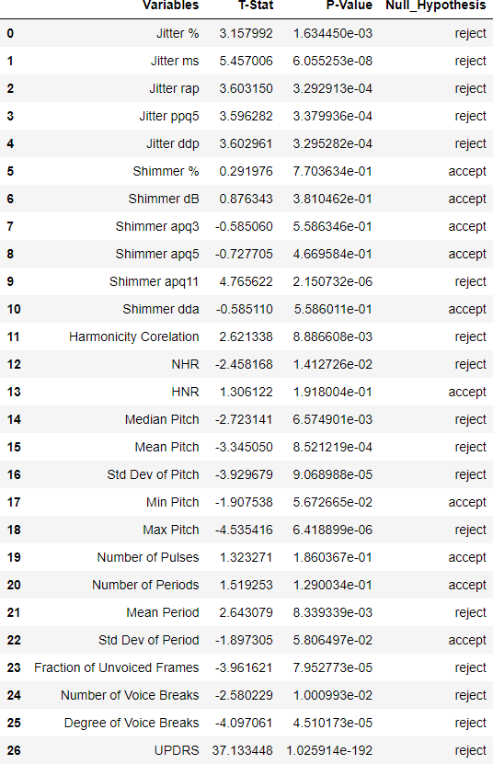
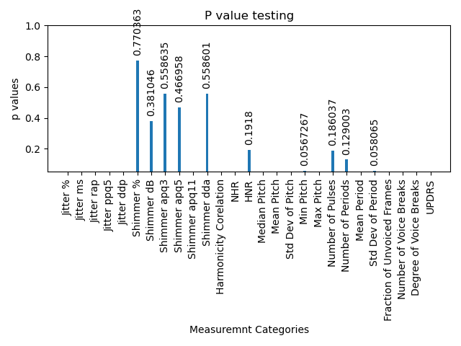
Result Interpretation
Notes:
Links:
https://www.pexels.com/photo/delivery-man-wearing-a-face-mask-carrying-boxes-4391478/
https://www.pexels.com/photo/man-wearing-a-face-mask-receiving-a-pizza-delivery-4393441/
https://www.pexels.com/photo/person-paying-for-food-delivery-with-a-credit-card-4393532/
https://www.pexels.com/photo/men-putting-food-on-a-thermal-bag-4393665/

Slide 16

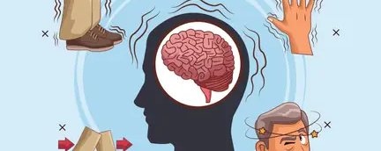
Differentiating Variables
Jitter %
Abs Jitter
Mean Pitch
After executing the hypothesis testing, we have found that following variables have p value less than 0.05, which means we reject the null hypothesis for these variables. In other way, we can say that these variables have impact over detecting the Parkinson’s Disease.
r.a.p
SD Pitch
p.p.q.5
Min Pitch
d.d.p
Mean Periods
a.p.q.11
Unvoiced Framed
Corr of HNR & NHR
No of voice Breaks
NHR
Degree of Voice Breaks
Median Pitch
UPDRS
Notes:
Links:
https://unsplash.com/photos/9cCeS9Sg6nU
https://www.pexels.com/photo/man-holding-digital-tablet-4484155/

Slide 17


Conclusion
Parkinson's disease (PD) affects 1-2 per 1000 of the population at any time[6]. PD gets worse over time and there is no cure of this disease but therapies and medicine can reduce the symptoms[7].
So, in the end we can say the old proverb for PD as well and that is ‘Prevention is better than cure’. This rule is applicable for all, specially for the elder people as they are in the high risk of PD.
At the same time, it can be said that people should give more focus in their diet and should do physical exercise in regular basis to keep away themselves from this uncurable disease.
Notes:
Links:
https://unsplash.com/photos/9cCeS9Sg6nU
https://www.pexels.com/photo/man-holding-digital-tablet-4484155/

Slide 18
THANK YOU!
Notes:
Links:
https://www.pexels.com/photo/birds-eye-view-photo-of-freight-containers-2226458/
https://www.pexels.com/photo/photo-of-man-in-bubble-jacket-while-holding-tablet-computer-4484077/

Slide 19

Reference
Lhttps://www.nia.nih.gov/health/parkinsons-disease#:~:text=Parkinson's%20disease%20is%20a%20brain,have%20difficulty%20walking%20and%20talking.
https://www.parkinson.org/understanding-parkinsons/causes
https://www.mayoclinic.org/diseases-conditions/parkinsons-disease/symptoms-causes/syc-20376055
https://www.judsonsmartliving.org/blog/7-scientifically-backed-ways-to-prevent-parkinsons-disease/
https://www.nia.nih.gov/health/parkinsons-disease#:~:text=The%20main%20therapy%20for%20Parkinson's,with%20another%20medication%20called%20carbidopa.
Tysnes, O.; Stostein, A.; Epidemiology of Parkinson’s Disease J Neural Transm (Vienna) 2017 Aug;124(8):901-905.
https://www.who.int/news-room/fact-sheets/detail/parkinson-disease#:~:text=There%20is%20no%20cure%2C%20but,with%20PD%20also%20develop%20dementia.
Notes:
Links:
https://www.pexels.com/photo/birds-eye-view-photo-of-freight-containers-2226458/
https://www.pexels.com/photo/photo-of-man-in-bubble-jacket-while-holding-tablet-computer-4484077/

